Slide 1

Beauty Parlour Billing System
Shreya Mahajan 20104001
Saniya Dutta 20104041
Anish Bhosale 20104033
Project Guide
Prof. Nahid Shaikh
Notes:
‹#›

Slide 2
Contents
Introduction
Objectives
Scope
Features / Functionality
Project Outcomes
Technology Stack
Block Diagram
Notes:
‹#›

Slide 3
1. Introduction
Beauty salon is an ironic figure in the western culture and in inner growing modern generation
Project allows the customers to create their account in our registry
Project provides facilities like supplier details, customer details, stock information.
Project provides good billing format so suppliers & customers understand easily about the items and rate of the items
Notes:
‹#›

Slide 4
2. Objective
To provide billing facility.
To easily edit the data.
To provide information of staff.
To Maintain Accounts of Customer.
To review the material, rate, quantity, amount, total and other information.
To easily enter the item information, supplier information and customer information .
Notes:
‹#›

Slide 5
1. Scope
To achieve efficiency
To build a user friendly billing system
To maintain the accounts of the customer accurately.
To save printing and postage costs
To improve cash flow position
To access fund easily
To have a proof of debt
To provide security to the database used by the system.
Notes:
‹#›

Slide 6
4. Feature /Functionality
Security
System provides a user id and a password to login users account providing high security
Graphical User Interface.
System provides information and procedures with good and current picture. System has a good and attractive billing format.
Comfortable Maintenance.
Any operator or developer can easily change the system as per requirement of system.
Payment methods
System provides user to make the payment through card (debit ,credit) , cash or UPI .
Notes:
‹#›

Slide 7
5. Outcome of the Project
Allow the users to create their personal account
Provide excellent security features
Allow user to add ,update ,edit items
Better graphic user interface making the system user-friendly
Easy transaction methods
Changeable nature of the system
Notes:
‹#›

Slide 8
6. Technology Stack
Database: MySQL JDBC Connector
Server: MYSQL
Language: Java (16.0.1)
Framework: Java Framework
Development Tools: ECLIPSE IDE

Slide 9
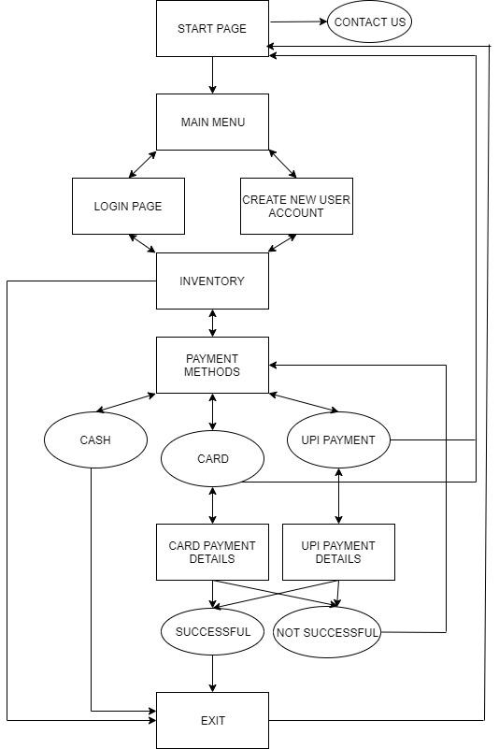
Block diagram

Slide 10
Thank You!
Notes:
‹#›

